Slide 1
Swift – Volunteer Contact Form
Team 26
Opportunity Hack 2018
***Add people***

Slide 2
Problem Statement

Slide 3
Scope of Problem

Slide 4
Proposed Solutions
Custom Website
Can provide all needed features but requires web hosting.
Can solve problem for a wider audience.
Qualtrics Survey Form with Salesforce Integration
Survey platform with access to one free survey and limited Salesforce integrations. Pricing varies for all features.
Salesforce Integrated Sign In Form
Highly customizable but requires some Salesforce development knowledge.
Create Salesforce Dashboard
Can export data to Excel, to load into Remind (to send texts) - YouTube Tutorial - just copy and paste
Can view reports and charts. Lots of options to filter data.

Slide 5
Custom Website

Slide 6
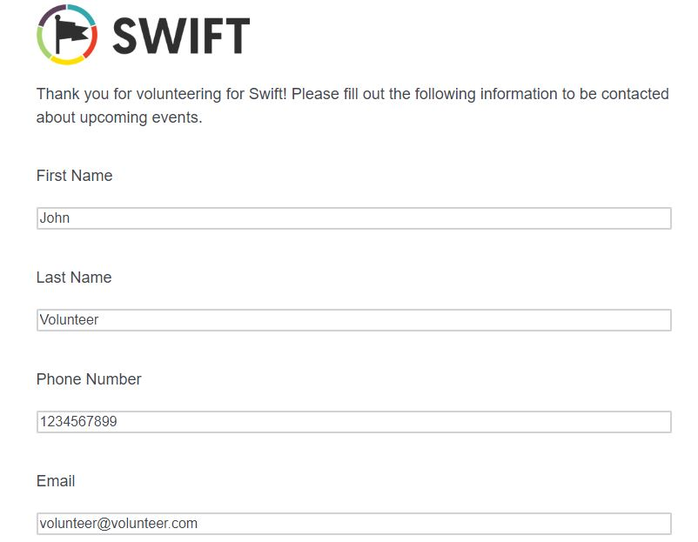
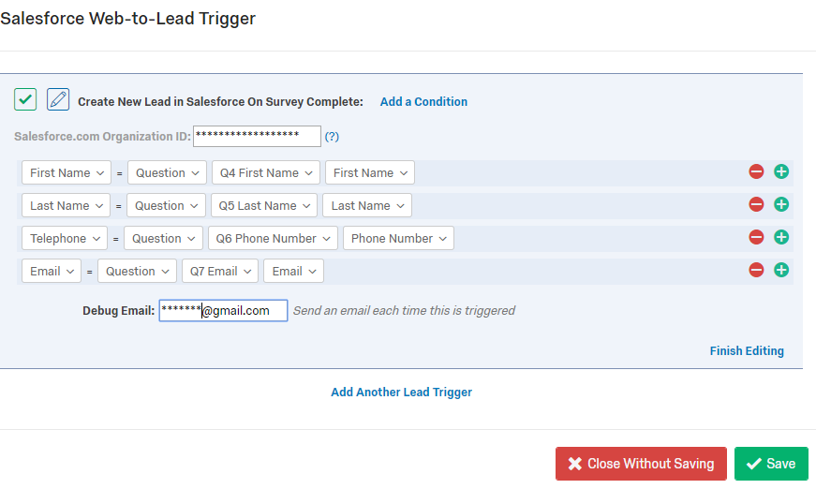
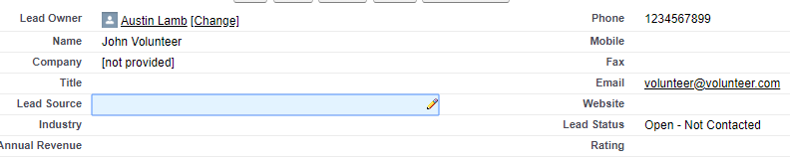
Qualtrics Survey Form with Salesforce Integration
Qualtrics Volunteer Sign Up with Salesforce Integration
Basic Example of Survey Up and Sign In
Qualtrics Settings
Resulting Salesforce Lead after survey completion

Slide 7

Integrate Form into Salesforce to track volunteering automatically as opposed to current manual process
Salesforce Integrated Sign In Form
Example Form that would load into volunteering Contact Info.
This form is on a Salesforce page but can also be a webpage
Salesforce Tutorial
Update Volunteering Hours in Salesforce

Slide 8
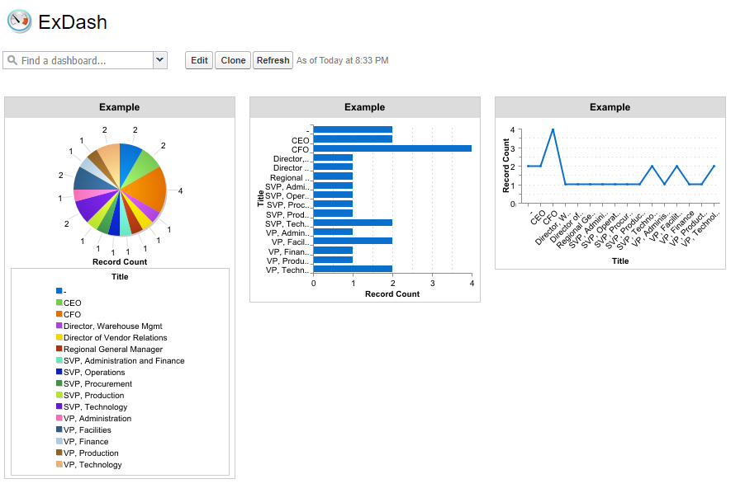
Highly customizable dashboard for summary view of Salesforce Data
Create Salesforce Dashboard

